Slide 1
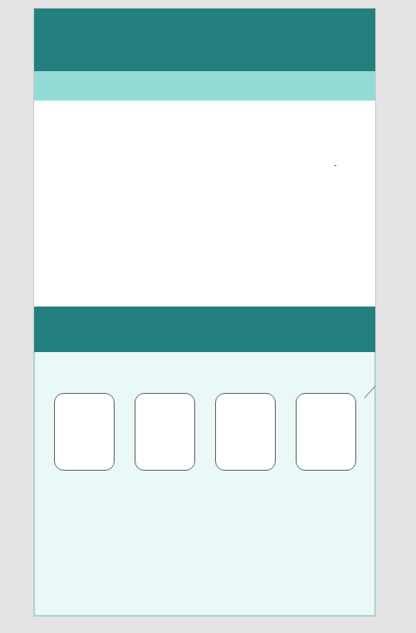
Video Plays Here
If window is selected while video is playing, the video should pause and display an test image in front of the video.
These Are Clickable images
Short press: plays video related to the image in the “video plays here area” (Any Video is Fine)
Long Press: forwards to new dummy page *Dummy page should have a Back button that brings you back to the original first page
These images need to be on a sliding carousel (Min 6 images and they don’t have to be different

